Slide 1
IT2070 – Data Structures and Algorithms
Lecture 05
Introduction to Recursion

Slide 2
Recursion –Example 1
Factorial
n ! = n * (n -1) * (n -2) * ... * 2 * 1, and that 0! = 1.
A recursive definition is
(n)! = {n * (n -1)! if n > 0}
{1 if n = 0}

Slide 3
Factorial -A graphical view
n!
We know 0! So we can build the tree backward
n *
(n-1)!
(n-1) *
(n-2)!
1!
1 *
0!

Slide 4
Exercise
Draw the recursive tree for 5!
How does it calculate 5! ? Is it:
Bottom to top calculation or
Top to bottom calculation ?
5!
5
Build the answer from bottom to top
*
4!
4
*
3!
3
*
2!
2
*
1!
initial condition.
1
*
0!

Slide 5
Factorial(contd.)
(n)! = {n * (n -1)! if n > 0}
{1 if n = 0}
Compare
int factorial(int n) {
if (n == 0)
return 1;
else
return (n * factorial(n-1));
}

Slide 6
Recursion
What is recursion?
A function that calls itself directly or indirectly to solve a smaller version of its task until a final call which does not require a self-call is a recursive function.

Slide 7
Recurrence equation
Mathematical function that defines the running time of recursive functions.
This describes the overall running time on a problem of size n in terms of the running time on smaller inputs.
  Ex: T(N) = T(N-1) + b
  T(N) = T(N/2) + c

Slide 8
Recurrence - Example1
Find the Running time of the following function
int factorial(int n) {
if (n == 0) //A
return 1; //B
else
return (n * factorial(n -1)); //C
}
Statement A takes time a → for the conditional evaluation
Statement B takes time b → for the return assignment
Statement C takes time:
c → for the operations(multiplication & return)
T(n-1) → to determine (n-1)!

Slide 9
Recurrence - Example1 (Contd.)
T(n) = a + c + T(n-1)
This method is called iteration method (or repeated substitution)
T(n) = Time to execute A & C

Slide 10
Exercise
Solve the recurrence
T(n) = T(n/2) + 2
You are given that
n = 16 and
T(1) = 1

Slide 11
Finding a solution to a recurrence.
Other methods
  Recursion tree.
  Master Theorem.

Slide 12
The recursion-tree method
Although the substitution method can provide a succinct proof that a solution to a recurrence is correct, it is sometimes difficult to come up with a good guess. Drawing out a recursion tree,is a straightforward way to devise a good guess. In a recursion tree, each node represents the cost of a single subproblem somewhere in the set of recursive function invocations.
A recursion tree is best used to generate a good guess, which is then verified by the substitution method.

Slide 13
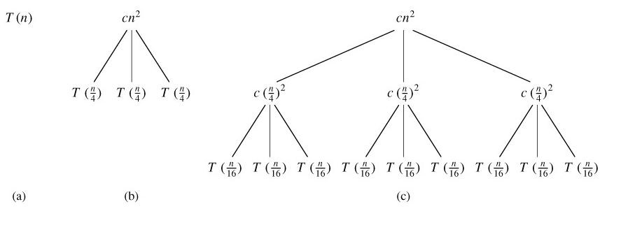
Recursion tree for T (n) = 3T (n/4) + cn²

Slide 14
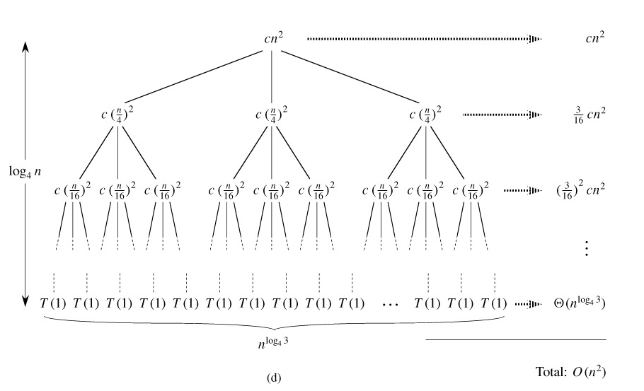
Recursion tree for T (n) = 3T (n/4) + cn²

Slide 15
The Master Method
The Master method applies to recurrences of the form
T(n) = a T(n/b) + f(n)
  where a ≥ 1 and b > 1, and f(n) is an asymptotically positive function.
  The recurrence describes the running time of an algorithm that divides a problem of size n into a subproblems, each of size n/b, where a and b are positive constants. The a subproblems are solved recursively, each in time T (n/b). The cost of dividing the problem and combining the results of the subproblems is described by the function f (n).

Slide 16
The master theorem
The master method depends on the following theorem.
Let a ≥ 1 and b > 1 be constants, let f (n) be a function, and let T (n) be defined on the nonnegative integers by the recurrence
T(n) = aT(n/b) + f(n),
where we interpret n/b to mean either ⌊n/b⌋ or ⌈n/b⌉. Then T (n) can be bounded asymptotically as follows.

Slide 17
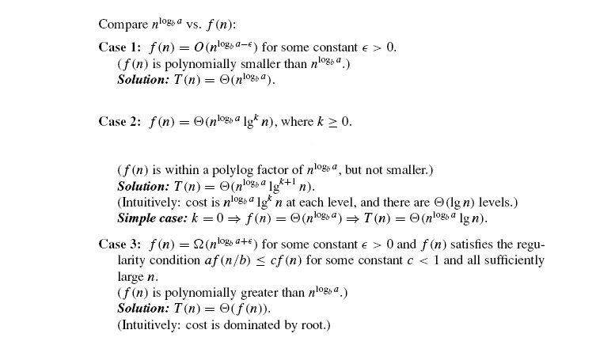
The master theorem

Slide 18
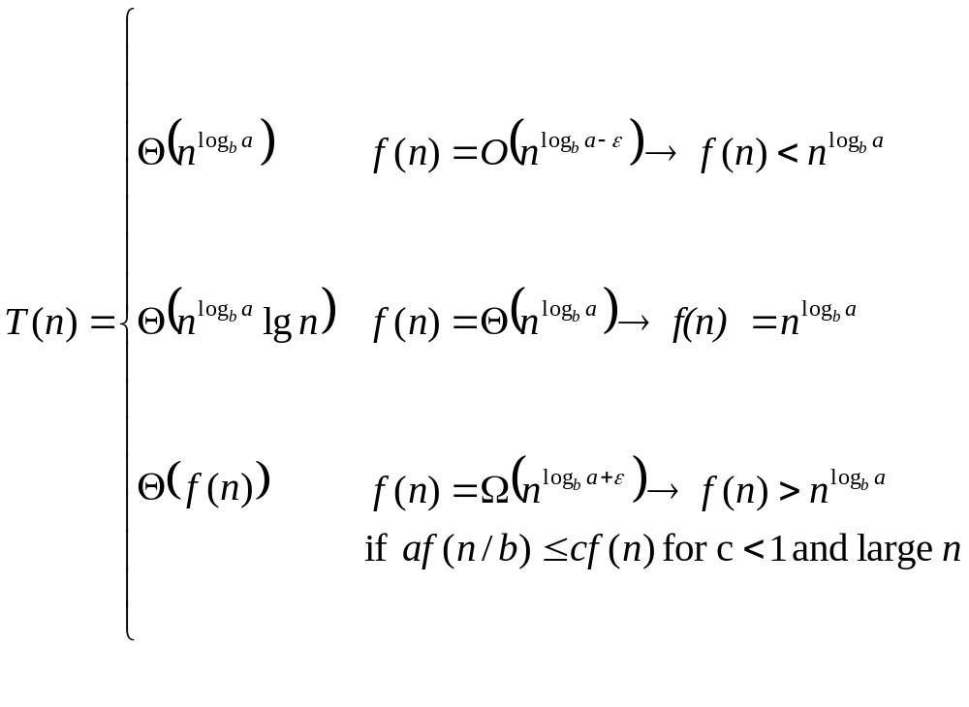
The master theorem

Slide 19
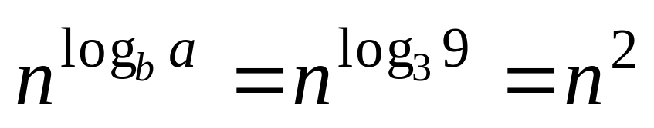
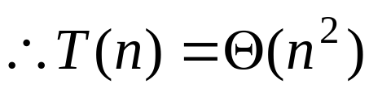
Master Theorem – Case 1 example
Give tight asymptotic bound for
T(n) = 9T(n/3) + n
Solution:
a=9, b=3, and f(n) = n.

Slide 20
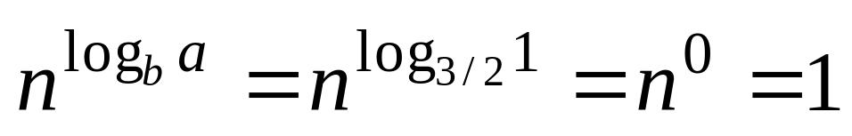
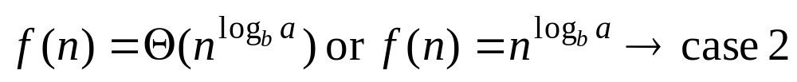
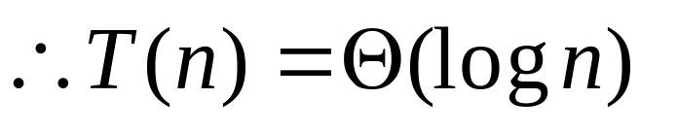
Master Theorem – Case 2 example
Give tight asymptotic bound for
T(n) = T(2n/3) + 1
Solution:
a=1, b=3/2, and f(n) = 1.

Slide 21
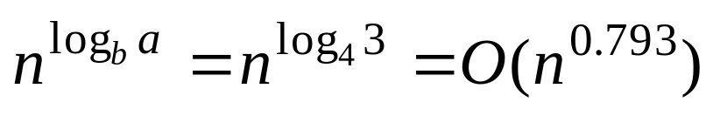
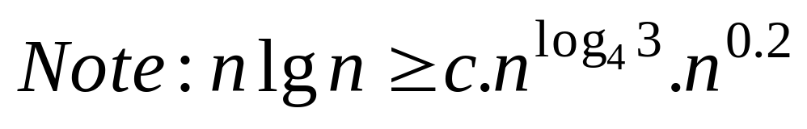
Master Theorem – Case 3 example
Give tight asymptotic bound for
T(n) = 3T(n/4) + n log n
Solution:
a=3, b=4, and f(n) = n log n

Slide 22
Exercises.
Use the master method to give tight asymptotic bounds for the following recurrences.
    T (n) = 4T(n/2) + n.
    T (n) = 4T(n/2) + n².
    T (n) = 4T(n/2) + n³.
Use the master method to show that the solution to the binary-search recurrence T(n) = T (n/2) + Θ(1) is T(n) = Θ(lg n).

